Slide 1
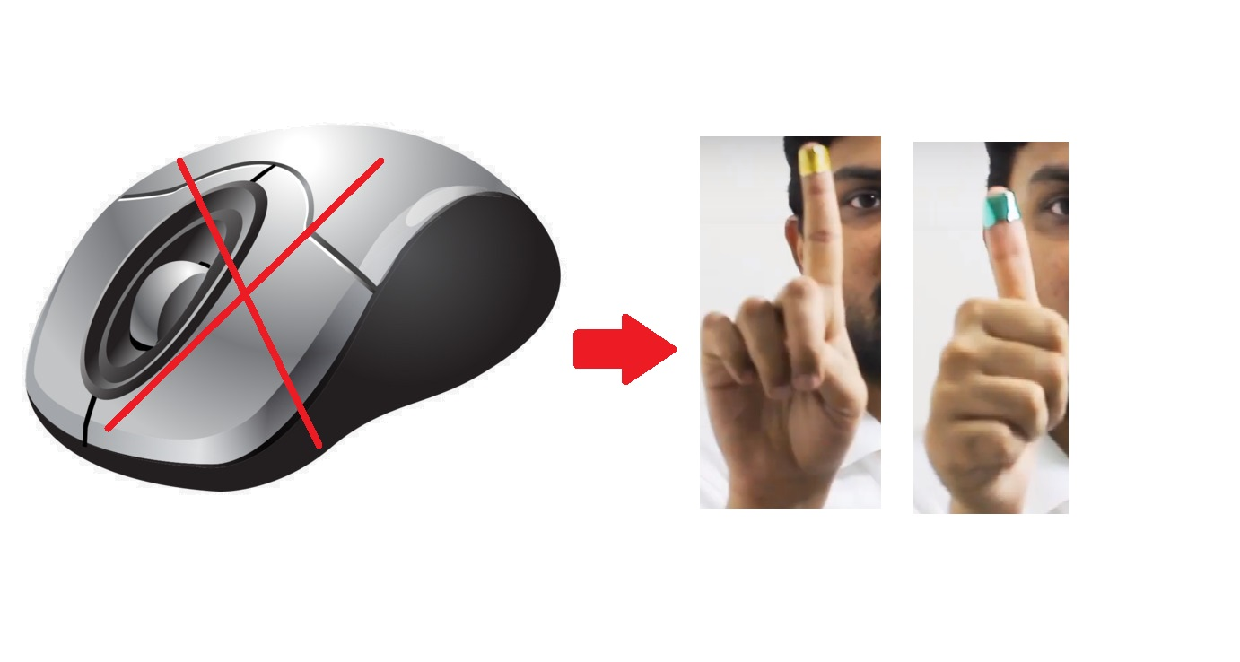
Mouse Control Using a Webcam based on Color Detection in OpenCV Python
By: Elham Hassan Goda Kedwany
hassanelham90@gmail.com

Slide 2
Introduction
In briefly computer vision is high - level understanding to computer from digital images and videos.
That is an application on computer vision. The whole project is based on python programming language and importing some libraries like open cv, pyplot from matplotlib, numpy and pyautogui module.
Computer vision based mouse can control and command the cursor of a computer or a computerized system using a camera.

Slide 3
Idea
Control cursor without any physical device
Track colored markers on the palm
Translate marker motion to cursor movements
Color 1 – Cursor Movement
Color 2 – Left Click
Color 3 – Right Click

Slide 4
Implementation stages
Image Acquisition
Image Preparation
Color Recognition
Cursor Control
Marker Motion Tracking
Marker Identification

Slide 5
Image Acquisition
Image Acquisition
Video Capture
Read Frame By Frame
Video Capture
Cam = cv2.VideoCapture(index)
Creates Video Object
Index → Index of Camera connected to computer or name of the video file, (0) if webcam used
cam → Video Capture object
Read frame from Video
ret, frame = cam.read()
Reads frame from the video
ret → boolean output. True, if frame is read correctly. False otherwise
frame → image with the frame of the video

Slide 6
Image Preparation
Image Preparation
Gaussian Smoothing
In the stage of Image preparation, we will remove noise from the images. We will use the most robust, the Gaussian blurring technique.
Gaussian smoothing
img_blur = cv2.GaussianBlur(img, ksize, sigma)
Gaussian Smoothing of Image
img → Original Image
ksize → size of neighborhood around the pixel to be considered
sigma → standard deviation (assign 0, by default)
img_blur → Output image

Slide 7
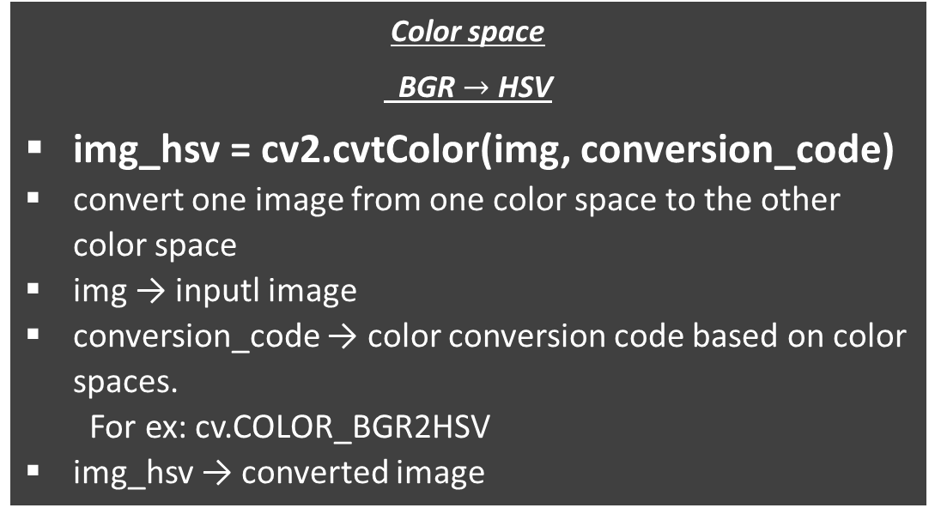
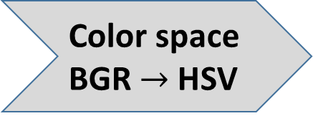
Color Recognition
Color Recognition
Color space BGR $→$ HSV
Thresholding based on Marker Color
Color space
BGR $→$ HSV
img_hsv = cv2.cvtColor(img, conversion_code)
convert one image from one color space to the other color space
img → inputl image
conversion_code → color conversion code based on color spaces.
For ex: cv.COLOR_BGR2HSV
img_hsv → converted image
Thresholding based on Object Color
img_threshold = cv2.inRange(img, lower_bound, upper_bound)
convert pixels based on their values
lower_bound < pixel value (in img) < upper_bound → pixel value = 255
Else, pixel value = 0

Slide 8
Marker Identification
Marker Identification
Contours for Colored Object
Contours with max area
In the stage of Object Identification, Now that you converted the original image into a binary image, you will find the contours of the colored objects, from the binary image.
Contours for Colored Object
cv.findContours(img, mode, method)
Finds contours in an image
img → source image
mode → contour retrieval mode
method → contour approximation method
Returns the following:
Img2 → resultant image with contours
contours → Array of detected contours
method → relationship between contours
Find Contours with ax Area
Ignore the smaller contours as errors
Calculate and use Features of contour with Max Area
Centriod
Bounding Rectangle

Slide 9
Marker Motion Tracking
Marker Motion Tracking
Centroid Location relative to Grid
In the stage of Marker motion tracking, you will use the contour features.
If it is in the top left region, the cursor should move towards the top left part of
your screen. If the marker is in the top center
region of the grid, the cursor should move towards
the left of your screen, and so on. If you hold the
marker in the central region, the cursor should
not move, and stay still. This is how you can
control the cursor, based on the marker motion.
Find Location of Marker Relative to Grid
Top - Left
Top – Center
Top – Right
Mid- Left
Mid – Center
Mid – Right
Bottom - Left
Bottom – Center
Bottom – Right

Slide 10
Cursor Control
Cursor Control
Move Cursor based on Marker Motion
Click based on Marker Color
In the stage of Cursor control, you will use the pyautogui library of python, to control the mouse cursor, and also click, based on the color of the marker.
We can control the motion of the mouse cursor by using The pyautogui.moveTo() function, that will instantly move the mouse cursor to a specified position on the screen.
We can control the mouse using the yellow marker, and we can just flash the green marker, whenever you need to left click, and we can just flash the red marker, whenever you need to right click. By Making sure there is no interference of any background object, with the marker colors.

Slide 11
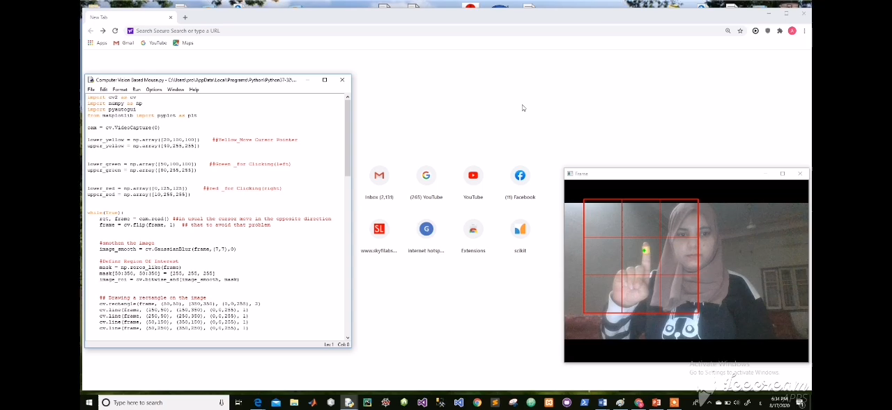
Results

Slide 12
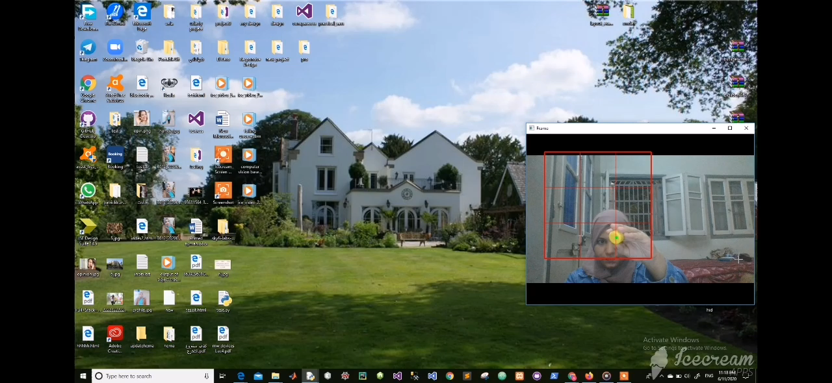

Slide 13
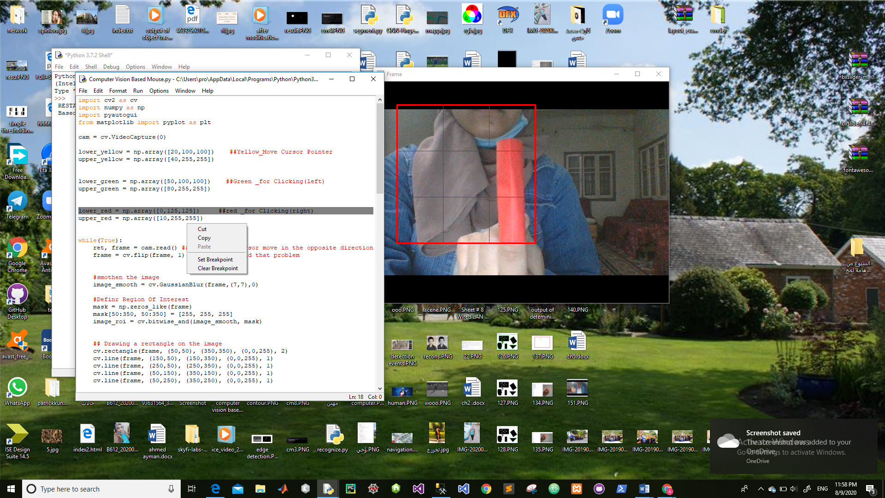

Slide 14
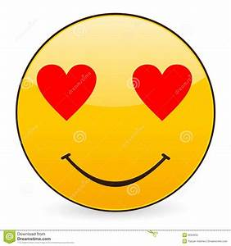
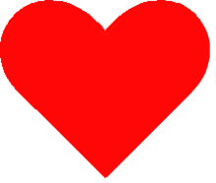



Slide 15


